Slide 1
What should I call you?

Slide 2
Bob

Slide 3
Bishop Gepert

Slide 4
Bishop Bob

Slide 5
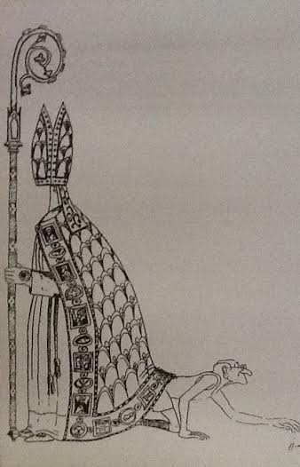
RETIREMENT

Slide 6
God brought me to this so that you would form me and I would form you more and more into who God created us to be. Our journey to God continues together.

Slide 7
THE INTERIM TIME
HEALING
AND
COMMUNITY

Slide 8
You must do the work healing and community building.
I can only name it and call you to it.

Slide 9
My Leadership Style:
The Wisdom Teachings of Three Greats
(2 Rabbis, 1 Abbot)

Slide 10
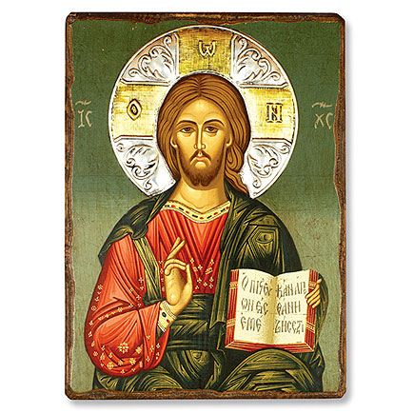
THE WISDOM OF JESUS

Slide 11
Jesus – living in the kingdom of God and God’s will above all else

Slide 12
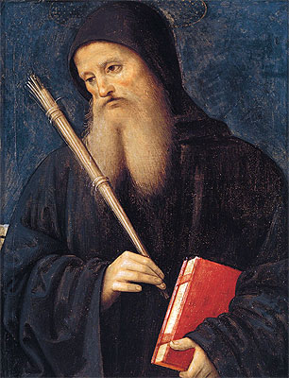
THE WISDOM OF THE RULE OF ST. BENEDICT

Slide 13
Rule of Benedict - moving deeper in relationship with God and organizing Christian Community

Slide 14
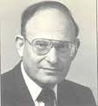
THE WISDOM OF FAMILY SYSTEMS

Slide 15
Friedman – self-work = health in the whole system, being a peaceful presence in the midst of turmoil, the ability to take a stand based on principles

Slide 16
JESUS/BENEDICT/FRIEDMAN Leadership based on principles and needs, emphasizing the message rather than the individual. Leadership which provides opportunities for spiritual growth and organizes community with clarity. Leadership which names the secrets, seeks transparency in all things, and works with motivated people and parishes for positive change.

Slide 17
The Right Reverend

Slide 18
Bishop-as-Abbot

Slide 20
HEALING – naming (expose to light), treatment, different way of living
COMMUNITY – intentionality, communal rules, greater purpose, common mission

Slide 21
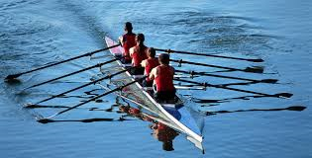
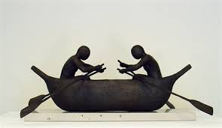
Rowing in the Same Direction
This Works
This Doesn’t

Slide 22
Tithing Statement: A Promise to You and the Mission of the Church
Anne and I give 10% of our household income to the Church. Our home parish receives 10% of my retirement income and 10% of my income from the Diocese of Central Pennsylvania will go to the church I am visiting/worshipping in each Sunday. In addition, we give to civic and charitable organizations beyond the Church and contribute to the support of an elderly parent. We pledge to do this without strings attached because we recognize that we receive spiritual benefits because of the giving, and we trust that God will use our giving for good.
- Robert Gepert & Anne Labat-Gepert

Slide 23
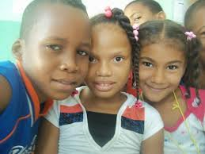
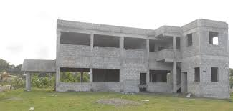
Diocese of the Dominican Republic

Slide 24
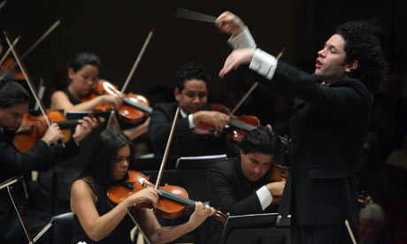
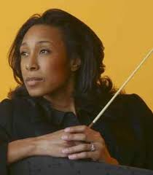
Making Beautiful Music Bishop and Diocese Together

Slide 25
Creep and Drift

Slide 26
Creep
Society in regression – inability to take responsibility
Anxiety characterized by blame and violence
Rampant narcissism and entitlement
Loss of respect for one another and for authority
Fierce independence which blinds us to seeing and living into the common good
Selfishness / Lack of willingness to sacrifice for the benefit of others

Slide 27
Drift
Why we exist as Christian people – our founding principles of making disciples, reconciling all people to God and one another – mission and ministry
What it means to be Episcopalian – the role of bishops/clergy/people each working in specific ways to bring God’s reign into existence
Who we are as people living together in intentional Christian community marked by radical hospitality, radical love, radical generosity, radical witness to the world of another way of living

Slide 28
Reform
Being called back to the center:
Gospel, Communal Documents

Slide 29
During our time together I will …

Slide 30
Promote Healing By
working on my own spiritual, emotional, and physical health
being present with you and listening
naming (bringing to light) dis-ease
seeking the council of elected and appointed leadership on creative ways to move forward
instituting a policy of rotating membership on committees and commissions
helping you to see the negatives as gifts

Slide 31
Promote Healing By
being accountable and transparent and by insisting on accountability and transparency from you
acknowledging pain and moving on
committing to loving you in a way that decisions are made for the health of the whole diocese
reminding you that you have all that you need to do God’s work in Central Pennsylvania and beyond
working with motivated people and parishes

Slide 32
Promoting Community by
forming monthly Clergy Council Meetings In each convocation
promoting prayer as the antidote to anxiety and the pathway to peace and intimacy with God and each other
creating learning opportunities in gatherings in the Northern, Middle, and Southern ends of the diocese
showing no favoritism and treating each parish the same, recognizing each as an important missionary outpost of the diocese

Slide 33
Promoting Community By
calling you to be vigilant regarding creep and drift in favor of promoting gospel principles and living into communal norms set by canons and diocesan policy
navigating the path between the extremes of consensus-style democracy on the one hand and unreceptive hierarchical forms on the other.
gathering you together as often as possible
being your bishop for this interim time

Slide 34
My prayer is that we will work together to give your new bishop a healthy diocese focused on the Gospel, community norms, and mission and ministry – a diocese practicing radical hospitality, radical love, radical generosity, radical witness to the world of another way of living.

Slide 35
What I’m asking of you
Pray the Scriptures (fruits of prayer)
Be aware of what we are to be about (members/disciples)
Cooperate – row in the same direction
See the Church beyond your parish
Gladly sacrifice for the sake of the whole – for the sake of mission and ministry
Live into the promises you made at your baptism and ordination
Stay in role

Slide 36
When the person God has already chosen to be your bishop is consecrated I will help her/him in every way I can and quietly return to retirement.

